Slide 1
Group 7
PM Review
Cliffen, Wen Rui, Yi Fan, Xian Shuang

Slide 2
Functionalities
Do you plan to drop/add any functionalities?
No plans to drop functionalities
Additional functionalities
Display student’s current timetable
Search for classes via class names
Do you plan to use any PHP frameworks?
No

Slide 3
Functionalities
Did you manage to finish login + 1 functionality? Yes.
What functionalities have you finished?
User and Admin login
Admin authentication and bootstrap
What is the IP address and admin password for your cloud deployment?
3.1.203.13
User: admin
Password: 123

Slide 4
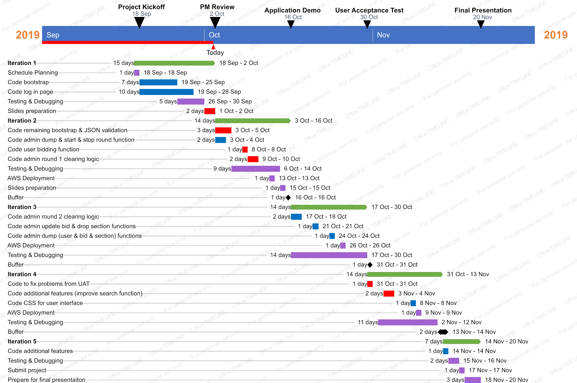
Schedule

Slide 5
Critical path
Critical path
Iteration 1
19/9
2
2
1
Create bug metrics
9
26/9
29/9
30/9
11
11
9
11
12
12
13
13
3
Create JSON checker
0
1
Test bootstrap & bug log
0
1
Debugging
0
19/9
2
4
3
Bootstrap without validation
18/9
22/9
9
11
12
12
13
13
1
1
0
5
1
Schedule planning
0
8
2
4
4
Bootstrap with validation
0
19/9
2
3
26/9
27/9
1/10
2
Admin login page
1
9
9
10
11
14
15
2
Preparation of slides
0
1
Create test cases for manual testing
1
2
Manual testing
1
1
1
5
8
3
4
19/9
10
10
11
12
14
15
2
3
2
User login page
7
9
10
Notes:
Scheduling planning [1]
Preparation of slides []
Create test cases []
Create bug metrics [2]
Admin Login page [2]
Bootstrap (1. Without validation 2. With validation) [2] [3]
Code json checker [3]
Test bootstrap using json checker & bug log [4]
Manual testing []
User login page [3]
Create simple test cases [2]

Slide 6
cal path
Iteration 2
03/10
1
3
3
Bootstrap validations & JSON validations
0
08/10
9/10
6
6
7
8
1
User bidding functions
0
2
Admin round1 clearing logic
0
1
3
6
6
7
8
03/10
06/10
11/10
13/10
14/10
15/10
4
5
9
10
11
11
12
12
13
13
1
2
2
Testing & Debugging
0
2
Testing & debugging
0
1
AWS database deployment
0
1
Testing & debugging
0
1
Slides preparation
0
2
Admin dump/start/ stop functions
1
08/10
2
3
4
5
6
6
9
10
11
11
12
12
13
13
1
Create JSON/Manual test cases
2
03/10
1
1
1
Create JSON & manual test cases
2
8
8
3
3
Notes:
Scheduling planning [1]
Preparation of slides []
Create test cases []
Create bug metrics [2]
Admin Login page [2]
Bootstrap (1. Without validation 2. With validation) [2] [3]
Code json checker [3]
Test bootstrap using json checker & bug log [4]
Manual testing []
User login page [3]
Create simple test cases [2]

Slide 7
al path
l path
C al path
Iteration 3
17/10
21/10
24/10
1
2
5
5
8
2
Code Admin Rd 2 Clearing Logic
0
1
Code admin update bid & drop section functions
0
8
1
Code admin dump (user & bid & section) functions
0
19/10
22/10
25/10
6
7
9
9
3
4
2
Testing & Debugging
0
1
Testing & Debugging
0
1
2
2
Testing & Debugging
0
5
5
9
9
21/10
24/10
17/10
5
5
1
1
1
Create JSON & Manual test cases
0
8
8
1
Create JSON Test cases
1
1
Create JSON & Manual test cases
0
3
4
6
7
9
9
2
2
5
5
8
8
27/10
26/10
10
10
11
13
1
Deploy database to AWS
0
3
Testing & Debugging
0
11
13
10
10
Notes:
Scheduling planning [1]
Preparation of slides []
Create test cases []
Create bug metrics [2]
Admin Login page [2]
Bootstrap (1. Without validation 2. With validation) [2] [3]
Code json checker [3]
Test bootstrap using json checker & bug log [4]
Manual testing []
User login page [3]
Create simple test cases [2]

Slide 8
Iteration 4
03/11
4
5
2
Code additional features (improve search function)
1
31/10
02/11
06/11
08/11
09/11
1
2
3
3
4
5
7
8
9
9
10
10
2
Code to fix problems from UAT
0
1
Testing & Debugging
0
2
Testing & Debugging
0
1
Code CSS for user interface
0
1
Deploy database to AWS
0
03/11
1
2
3
3
4
6
7
8
9
9
10
10
3
Code additional features (student timetable)
0
4
6
10/11
11
13
3
Testing & Debugging
0
11
13
Notes:
Scheduling planning [1]
Preparation of slides []
Create test cases []
Create bug metrics [2]
Admin Login page [2]
Bootstrap (1. Without validation 2. With validation) [2] [3]
Code json checker [3]
Test bootstrap using json checker & bug log [4]
Manual testing []
User login page [3]
Create simple test cases [2]

Slide 9
Iteration 5
14/11
15/11
17/11
18/11
1
1
2
3
4
4
5
7
1
Code additional features
0
2
Testing & Debugging
0
1
Submission of final project documents
0
3
Prepare for final presentation
0
1
1
2
3
4
4
5
7
Notes:
Scheduling planning [1]
Preparation of slides []
Create test cases []
Create bug metrics [2]
Admin Login page [2]
Bootstrap (1. Without validation 2. With validation) [2] [3]
Code json checker [3]
Test bootstrap using json checker & bug log [4]
Manual testing []
User login page [3]
Create simple test cases [2]

Slide 10
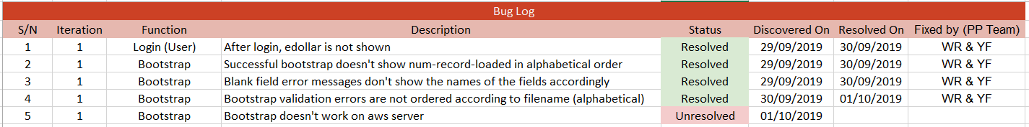
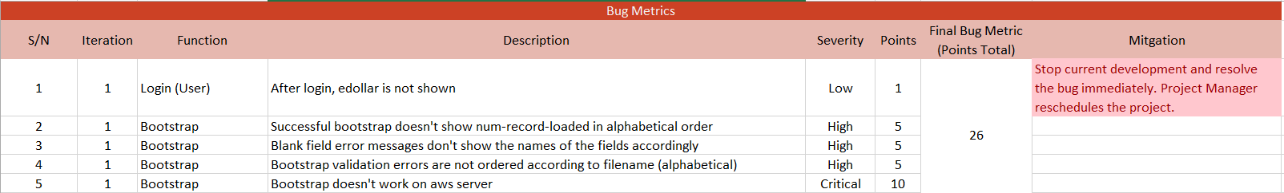
Bug Metrics
What is the current value for the metric & did you have to take any action according to your mitigation plan?

Slide 11
Roles & Responsibilities
Who is doing what (Project Manager, coder, etc.)?
What is the rotation plan? List specifically the PM is in charge of which milestone?

